Slide 1

Software Design & Analysis
Course Code: CS3004
Credit hours: 3

Slide 2

Introduction
Lecturer: Nasreen Akhtar
Department of Computer Science
Email: Nasreen.akhtar@nu.edu.pk

Slide 3
Introduction – Cont’d
Course Objective
Course Format
Attendance Policy
Honor Code
General Guidelines

Slide 4
Google classroom code
euyp5tv

Slide 5
Today’s Agenda
Course Introduction
Course Objective
Course Organization
Course Outline

Slide 6
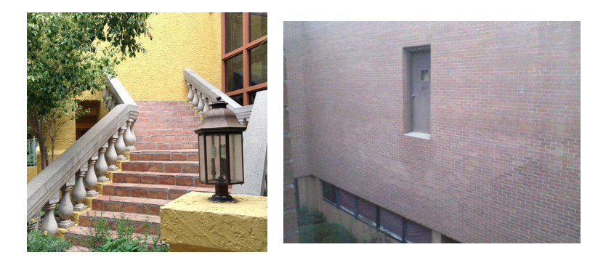
Why we need software Architecture Activity?

Slide 7
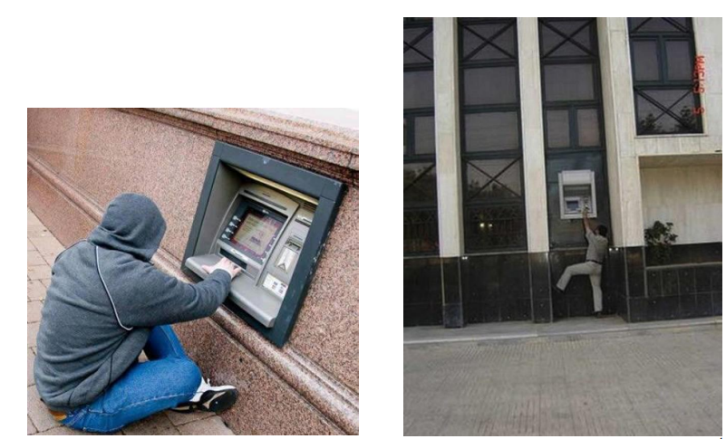
Why we need software Architecture Activity?

Slide 8
Why we need software Architecture Activity?
What do you think is wrong in these real-life scenarios?
The requirements are correct!
» A staircase next to the outer wall
» A door on the first floor
» An ATM outside the bank branch
The design is flawed!
» The execution based on the design results in disaster

Slide 9
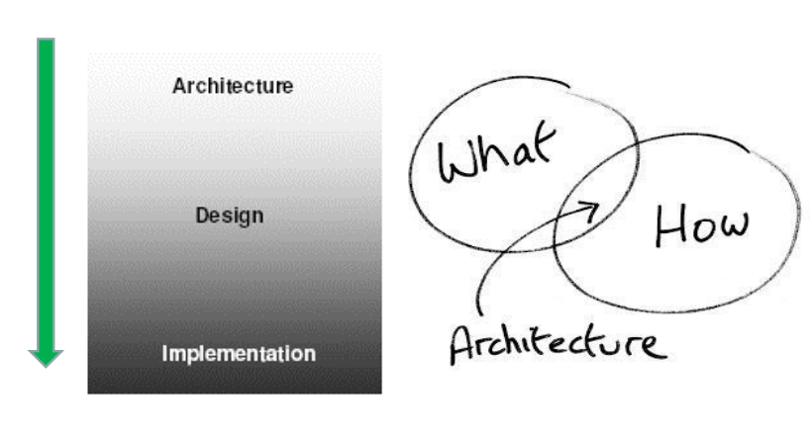
Software Design vs Architecture

Slide 10


